Slide 1
Department of Computer Science
CS F364 – DESIGN AND ANALYSIS OF ALGORITHMS
RECURSIVE SELECTION SORT AND MASTERS THEOREM
PORTIONS: As specified in handout and the contents taught in class. Class notes is must. Refer to the textbook as mentioned in handout
PLEASE NOTE THAT PPT IS JUST AN ADDITIONAL REFERENCE.

Slide 2
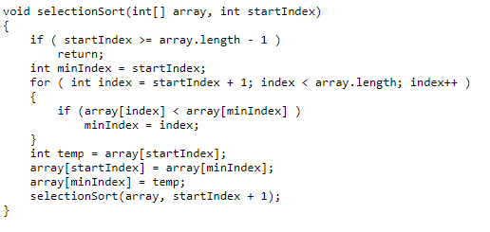
Recursive Selection Sort
Worst case complexity: O(N^2)
Self Study: Finding the Kth smallest element
(HINT: COMBINE SELECTION SORT AND QUICK SORT)
AVERAGE RUNNING TIME : O(N)
Refer to book R2 mentioned in handout

Slide 3
Solving the recursive equations
Mathematical Induction Method
Substitution method
Recursion Tree
Masters theorem

Slide 4
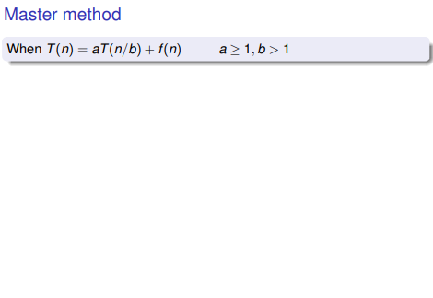
Masters theorem

Slide 5
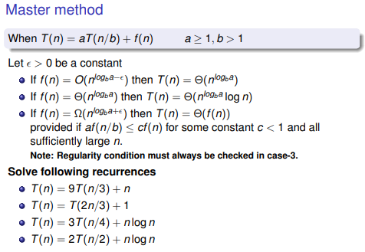
Masters theorem

Slide 6
THANK YOU

